Slide 1
MODELING AN NFL DRAFT BOARD

Slide 2
WHERE HAVE WE BEEN?
A trip through eight months of numbers…

Slide 3
OUR INSPIRATION THE NFL DRAFT
Notes:
JP
Talk about why we wanted to do the project; sports/statistics passion + wanting to uncover the intellectual side of football

Slide 4
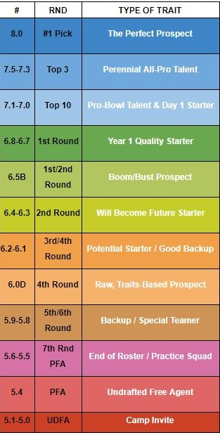
THE FINAL PRODUCT
Individual Player Grading System
Mock Draft
Podcast
Notes:
CG
Explain what the model will do and how we plan to podcast

Slide 5
TIMELINE
Fellows approval!
Gathering data; Meeting #1 w/ Dr. Groves
Meeting #2 w/ Dr. Groves
A whole lot of roadblocks…
Getting ready for today!
MAY
JUN
JUL
AUG
SEP
OCT
NOV
DEC
JAN
Leadership Lab; Finding modeling program
Gathering MORE data
Meeting #3 w/ Dr. Groves; Modeling begins
Adding to the data; Meeting #4 w/ Dr. Groves; Tweaking the model
Notes:
JM
Take it step by step – what did we do at each point

Slide 6
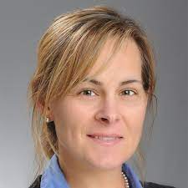
MEET DR. GROVES
Dr. Groves ASSOCIATE PROFESSOR OF ECONOMICS
Townson University
Notes:
CG
Touch on how Dr. Groves has worked with us

Slide 7
LET’S LOOK AT THE NUMBERS
EXCEL SHEETS AND STATA MODELS…
Notes:
BOTH – JM Excel CG model

Slide 8
WHAT HAS CHANGED?
And where are we now?

Slide 9
OUR EXPECTATIONS
Finding and learning program, collecting stats, and stats… and stats
Podcast to discuss our processes, findings, and new experiments (+live podcast on draft night)
Modeling, finding errors, more modeling, more errors, more modeling
0
50
100
SEPT. 1
MARCH 1
Notes:
JM
Talk about our original plan

Slide 10
A LOT
Turns out we need
of data
+ other roadblocks
Notes:
CG
Talk about how the plan changed because we did a bunch of data collection, and then hit a bunch of roadblocks like college, concussion, special stats etc, and by November, when we were ready to fully dive into modeling, we realized that we needed a lot more data than we realized, so now it is kind of simultaneous data collection and doing modeling. BASICALLY: we’ve had to pivot by spending more time on data than we thought, but we haven’t really had to change scale yet

Slide 11
WHAT HAVE WE LEARNED?
Gaining a new understanding of what it means to model…

Slide 12
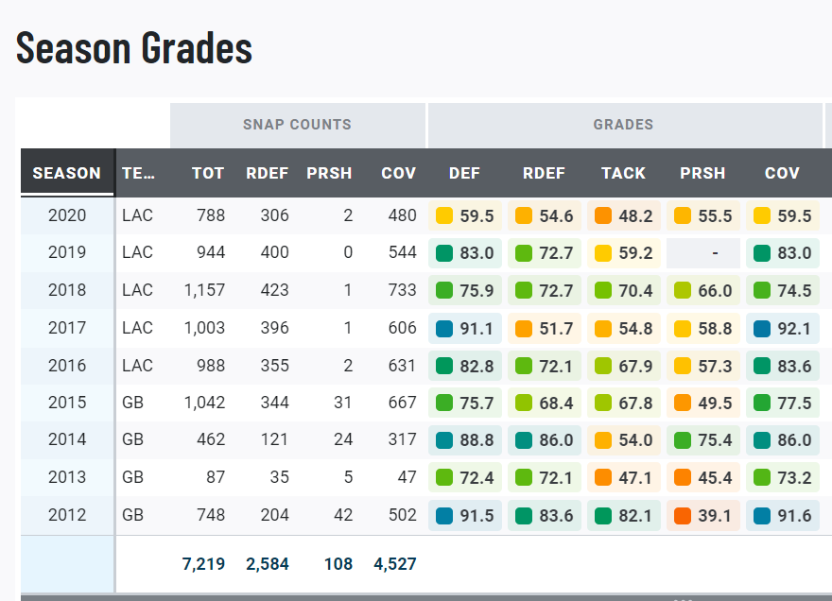
THE NFL STANDARD… and other stats
Pro Football Focus
Why we use it
Average Grades
Notes:
JM
Talk about PFF and other stuff we learned about collecting data

Slide 13
FINDING OUR PROGRAM
Stata vs. IBM SPSS
Not coding dependent
Plenty of capabilities
Notes:
CG
Explaining how we selected IBM SPSS, were told to go into excel, and then switched to stata because dr groves likes it

Slide 14
MODELING WITH CATEGORIES
ACCURACY
Completion %
INTELLIGENCE
Turnover Rate
ATHLETICISM
Rushing Yards/TDs
STRENGTH
Deep Ball %
WININING
Accolades, Wins, etc.
$$$
*Contract Data!
Notes:
JM
Talk about how we originally thought that it would just come down to numbers in and numbers out, but we learned that every player was going to need specific scores for athleticism, accuracy, ability, etc to make it much easier to simplify and compare players and talk about how were excited that we may use contract data to compare across positions

Slide 15
SPRING PLANS
Our goals for the upcoming months…

Slide 16
PLANNING OUR UPCOMING MONTHS
PRESENT → March 15
Watch the Super Bowl
Create a SoS statistic
Refine the model w/ two more draft classes + contract data
Finalize model
Watch the NFL Combine
March 15 → May 7
Model 2022 NFL Draft
Podcast Episode 1: Our Process (Mar. 15)
Podcast Episode 2: Modern Day Football Metrics (Mar. 30)
Podcast Episode 3: Official 2022 Mock Draft (Apr. 15)
LIVE Podcast Episode 4: Draft Day (Apr. 28)
Podcast Episode 5: Wrapping Up (May 7)
May 7 → END
End of Year Fellow’s Presentations and Responsibilities
Self-Assessment – How did we do?
Notes:
CG

Slide 17
THANKS!
Any questions?
Contact through:
s22cgrimes@severnschool.com
s22jmeyer@severnschool.com
Visit our website:
www.severnfellows22teamdraft.weebly.com

